Slide 2
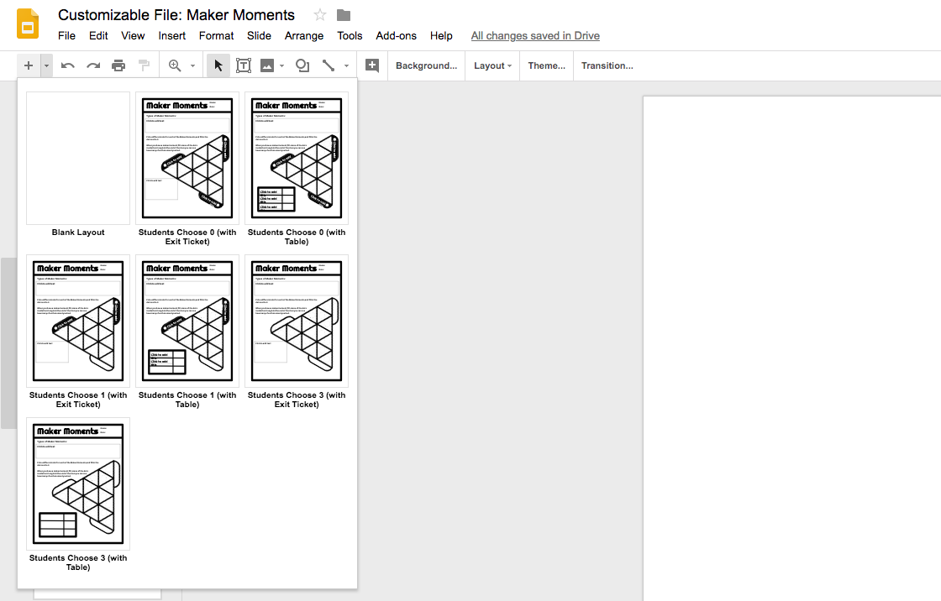
Choose a slide layout with the correct number of blank “Students Choose” elements, and with a table to count moments or space for an Exit Ticket question.
Fill in customizable spots:
Insert the types of moments you want students to look for in the top box. Use the example text on slide 2, or make up your own. (Note that for Design Process, you may choose a part of the process to have students watch for.)
Put short name of moment type in all capital letters (in parentheses on Slide 2) into labels around the triangle.
If applicable select an exit ticket question from slide 2, or write your own.
If applicable fill in the moments on the table.
See Slide 3 & 4 for two examples.

Slide 3
Maker Elements with suggested “Maker Moments” descriptions:
AGENCY
Set your own goal.
DESIGN PROCESS (DESIGN, TEST, or ITERATE)
Improve your design after testing it out. (ITERATE)
Test you design to see how it works. (TEST)
SOCIAL SCAFFOLDING (SOCIAL)
Learn from classmates, help them learn from you.
PRODUCTIVE RISK-TAKING (RISK)
Try something that you’re not sure will work.
Try various materials and techniques.
TROUBLESHOOTING (TROUBLESHOOT)
Try various materials and techniques.
BRIDGING KNOWLEDGE (BRIDGE)
Used something I/we learned in another project on this project.
CONTENT KNOWLEDGE (CONTENT)
Used a SCIENCE/MATH/ENGLISH concept to make your project better.
Learn something new about SCIENCE/MATH/ENGLISH concept through making.
Suggested Exit Ticket Questions (Below triangle):
Pick one Maker Moment. What was the moment? How did it help your project?
Which color did you have the most of? Why do you think you had most of that type?

Slide 4
SOCIAL
RISK
ITERATE
PRODUCTIVE RISK-TAKING: Try something you’re not sure will work.
SOCIAL SCAFFOLDING: Learn from classmates, help them learn from you.
ITERATE: Improve your design after testing it out. (Part of the Design Process.)
Which color did you have the most of? Why do you think you had most of that type?

Slide 5
SOCIAL
RISK
RISK
SOCIAL
PRODUCTIVE RISK-TAKING: Try something you’re not sure will work.
SOCIAL SCAFFOLDING: Learn from classmates, help them learn from you.

